Slide 1
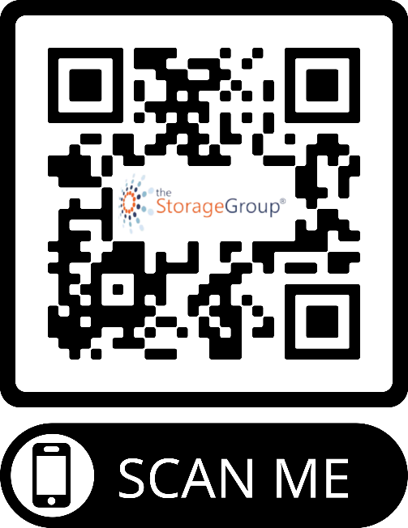
Increase Your Facility’s
Local Online Presence Through
Digital Marketing Tools
Presented by:
Steve Lucas
The Storage Group®
CEO & Managing Partner
slucas@storagegroupinc.com
(407) 565-6625
Notes:
Hello! My name is Steve Lucas. The CEO & Managing Partner at The Storage Group and I am going to discuss INCREASING YOUR FACILITY’S LOCAL ONLINE PRESENCE THROUGH DIGITAL MARKETING TOOLS.

Slide 2
Presentation Agenda
Digital Marketing Tools:
Website Development
Progressive Web Apps
Online Rentals & Payments
Search Engine Optimization
Google Business Profile
Local Listings
Pay-Per-Click Advertising
Social Media
Competitive Price Analysis
Performance Dashboard
Notes:
These are just some of the digital marketing tools we are going to discuss during our presentation.

Slide 3
WEBSITES
Potential tenants do their self storage facility research online before making decisions
Make sure your website is both search engine friendly and user-friendly
Make sure your website promotes security, both on-site and online
Potential tenants expect to be able to secure storage online with an Amazon-like experience
Offer progressive website and apps for optimal user experience
Almost 90% of users would go to a
competitor after a bad website experience
Notes:
Keep in mind, while you are in the process of building your brick and mortar facility, you want to also have a team working on your website. You want to have it launched before the facility opens so you can get Google to crawl and rank your website, but also to start taking reservations for when you are open. Here are some reasons why your website is so important. (Slide)

Slide 4
STRONG DIGITAL PRESENCE
Digital Marketing:
Increases your facility’s online footprint
Attracts possible tenants, where they are on various platforms
Shows your storage facility’s services, storage availability, and contact information to possible tenants across the web
Notes:
First of all let’s start with why it is important to have a strong digital presence. Just like the physical location of your facility is important, you need to make sure your website has a strong presence online. (Slide)

Slide 5
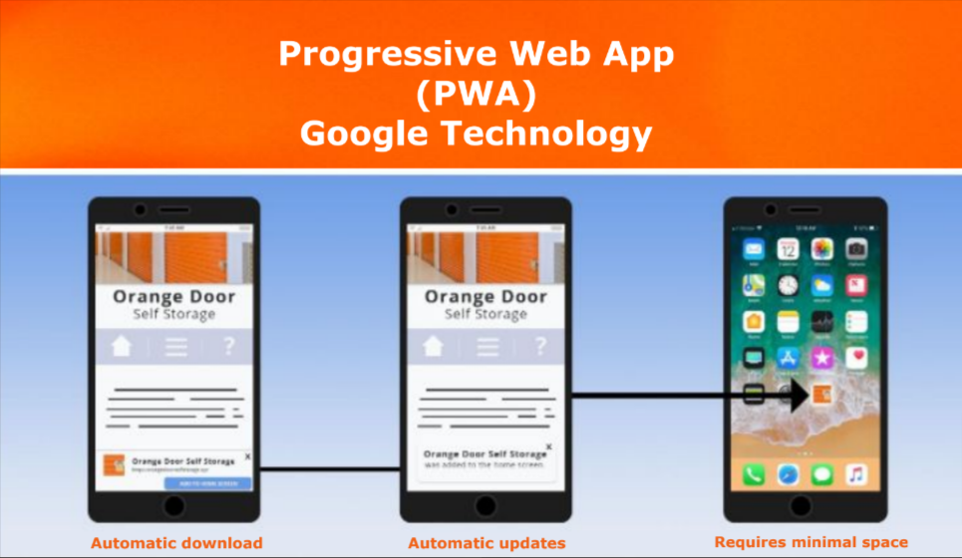
PROGRESSIVE WEB APP (PWA)
On average, it was recorded that app usage accounts for about 89% of all mobile media time, while the other 11% is spent on websites.
PWAs combine the best features of both types of technology into one interactive, online experience.
Notes:
When you are thinking about your website, you want to make sure it is a progressive web app (PWA). That way your tenants can download your website app to pay their monthly bill. They don’t have to remember your website’s URL. (Slide)

Slide 6
PROGRESSIVE WEB APP (PWA)
Will differentiate your facility by:
Improving website traffic
Generating higher click through rates
Providing the most up-to-date service to your potential tenants
Notes:
How will a progressive web app help differentiate your facility from competitors?

Slide 7
ONLINE RENTALS & RESERVATIONS
Allows you to:
Expand your customer base
Increase reservations 24/7
Improve customer experience
Get data-driven insights
Gain a competitive advantage
Potentially operate an unmanned facility
Notes:
While thinking about your website, you want to think about what features you want to offer your customers. In this day and age, most people expect to do research online for possible businesses, see pricing, availability, features, etc. So, offering online rentals and reservations is essential.

Slide 8
PMS SOLUTIONS
As you may know, a property management system (PMS) software solution is designed to help storage facility owners and operators efficiently manage their operations.
It typically includes features such as:
Rental management
Customer account management
Unit availability tracking
Billing and invoicing
Online reservations and payments
Tenant communication
Notes:
As you may know, a property management system (PMS) software solution is designed to help storage facility owners and operators efficiently manage their operations.

Slide 9
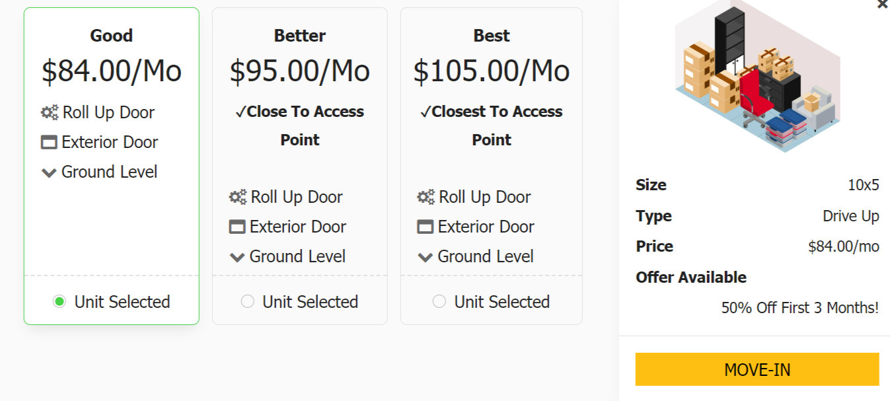
GOOD, BETTER, BEST OPTIONS
Utilize a property management system that generates good, better, and best options for tenants. This gives tenants choices and provides a better overall user experience.
Notes:
What other options do you want to offer on your website? If your rental tool offers users during the rental process the ability to pick between different options, it gives them more options and it allows you to upsell without any additional work on your part.

Slide 10
SEARCH ENGINE OPTIMIZATION
Brings organic search traffic to your website
Generates cost-effective leads for people searching for self storage
Helps build your facility’s brand recognition and trust
Top organic positions display your facility ahead of your competition
Notes:
Search Engine Optimization or SEO according to Google is about helping search engines understand your content, and helping users find your site and make a decision about whether they should visit your site through a search engine queries..(alt tags, meta tags, content, photos, etc.)

Slide 11
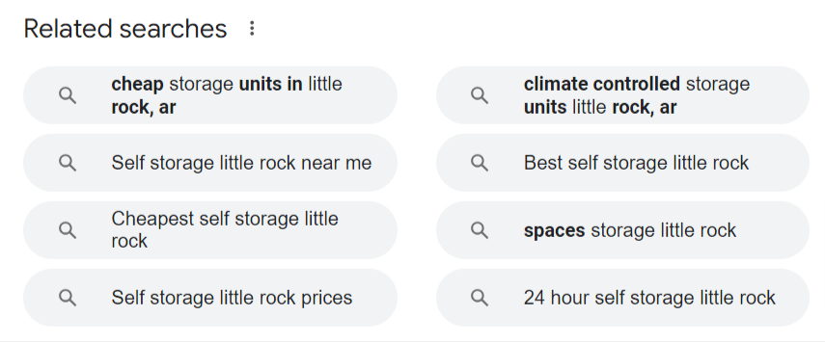
GOOGLE’S RELATED SEARCHES
What long-term keywords do you need to target?
Are your targeted keywords the same as what people are actually searching for?
It also gives you some insight about what is important to potential tenants.
Notes:
What targeting keywords are people using to find a facility like yours. If you go to Google.com and type in your targerted keywords into a search box. Hit enter. Scroll to the bottom of that search engine results page will also show related searches to your own. (Slide)

Slide 12
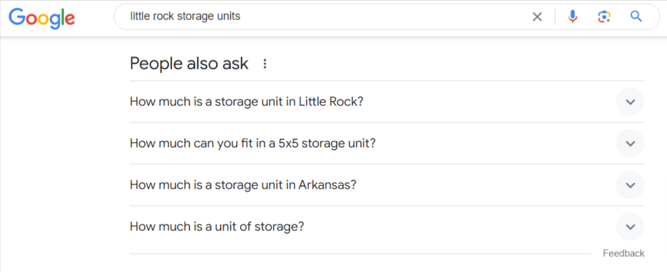
GOOGLE’S PEOPLE ALSO ASK (PAA)
FAQ Page on your website, to answer questions commonly ask. It will help you in results.
PAA provides users with additional information they may be looking for from their initial search query
The PAA section appears on the first page of Google in prominent placement towards the top of page one.
Notes:
Google also has an area on the search engine results page called People Also Ask. This is a great place to get frequently asked questions for the FAQ Page on your website.

Slide 13
GOOGLE BUSINESS PROFILE
Google Business Profile allows you to take charge of the way your business appears on Google Search and Maps. With your Business Profile, you can connect with customers, post updates, list your services, and more.
Helps you engage with your customers
Allows for feedback and reviews
Builds your brand recognition
Analyze results with Google Insights
Notes:
It’s 100% free to create and manage your Google Business Profile. It allows you to take charge of the way your business appears on Google Search and Maps, when you type your facility;s name into Google search. You want to make sure all information is accurate, especially website URL, address, phone number, hours, etc . (Slide)

Slide 14
LOCAL LISTINGS
Local listings must include consistent and correct NAP (name, address, and phone number) information about your facility across the web
Proper local listings are one of the quickest ways to create trust with Google
Helps increase your business’s visibility in local search
Drives extra traffic to your website
Notes:
A local listing is the online mention of a business's name, address, phone number and website address for a local business. These listings can appear in several places including local directories, social media, websites, blogs, etc.

Slide 15
PAY-PER-CLICK
Gives facilities the ability to run ads specifically for your target audience
You only pay for the people who click on your ads
Sponsored ads are high in the search engine results pages (SERPs)
Enhance competitive advantage in saturated markets
Notes:
SEO is a long term strategy. It takes time for the search engines to crawl your website and rank well organically. While that is happening, you may want to consider running a PPC campaign. It can help as soon as the ads are launched. - Sponsored

Slide 16
SOCIAL MEDIA
Having a strong social media presence is a great way to increase likes, comments, shares, reviews, and engagements with current as well as potential tenants.
74% OF CONSUMERS RELY ON SOCIAL NETWORKS TO GUIDE THEIR PURCHASE DECISIONS
Notes:
Social media is a great way to increase engagement with your tenants and potential tenants through likes, comments, shares, reviews, more. It can definitely help with their purchasing decisions.

Slide 17
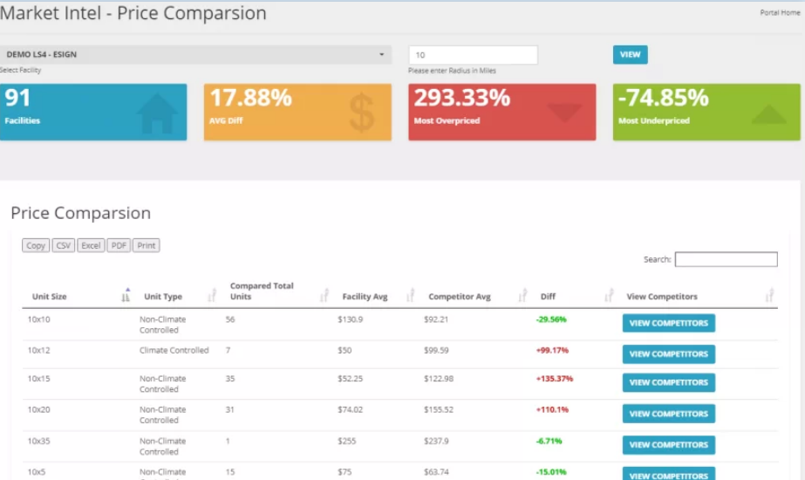
COMPETITIVE PRICE ANALYSIS
There are tools that can pull local storage unit prices within a radius of a facility.
Find a tool that allows you to compare prices based on storage unit sizes and types of storage.
This will allow you to gain valuable insights and remain competitive in your self storage target market.

Slide 18
PERFORMANCE DASHBOARD
As you utilize these digital marketing tools to help your facility stand out from the competition, you need to be able to monitor your results.
You’ll want to monitor: Rentals, Abandonments, Google Analytics, Keyword Ranking Reports, Google Business Profile Insights, Customer Reviews, and more.
Notes:
As you utilize these digital marketing tools to help your facility stand out from the competition, you need to be able to monitor your results.

Slide 19
Questions

Slide 20
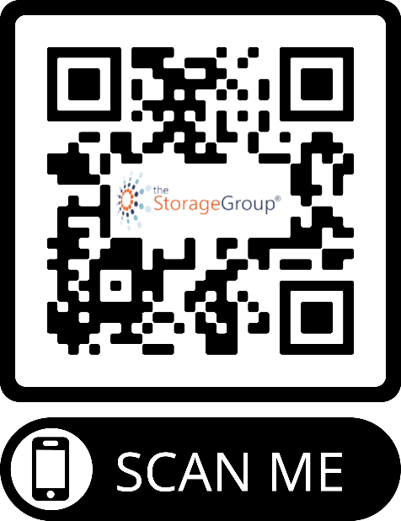
THANK YOU!
Presented by:
Steve Lucas
The Storage Group®
CEO & Managing Partner
slucas@storagegroupinc.com
(407) 565-6625
Notes:
Thank you for your time and attention. Our team of digital marketing experts specialize in the storage industry. Please let me know if you have any questions.

